Slide 1
App Design & Specification
Ubiquitous Computing – Fall 2025
Ioannis Thomas Pavlidis

Slide 2


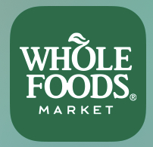


The Meaning of Color
Love/Intensity
Joy/Intellect
Trust/Calm
Nature/Growth
Royalty/Wisdom

Slide 3
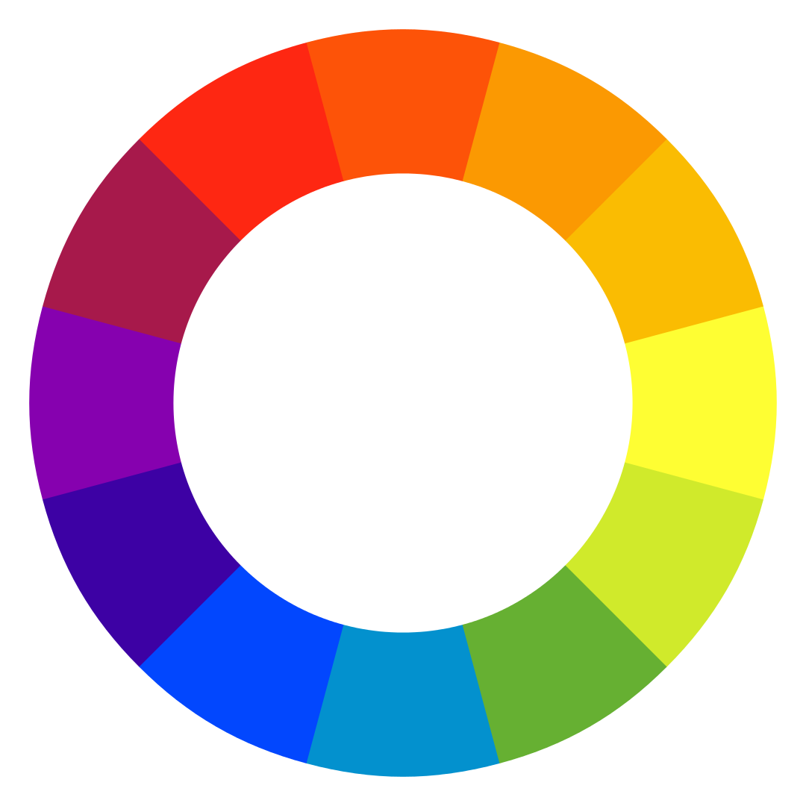
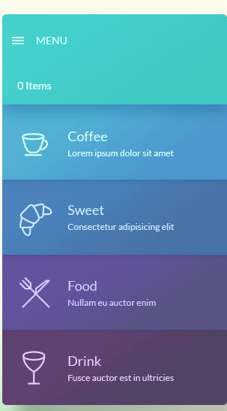

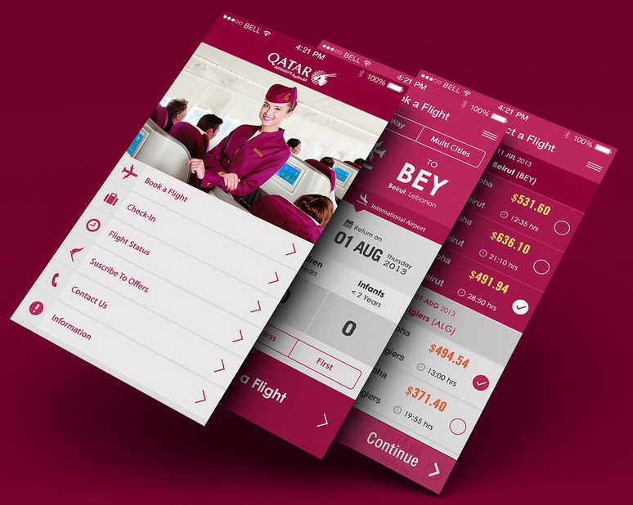
Color Mixtures
Analogous
Complementary
Monochromatic
Pleasant to linger
Attention grabbing
Pleasant to linger

Slide 4
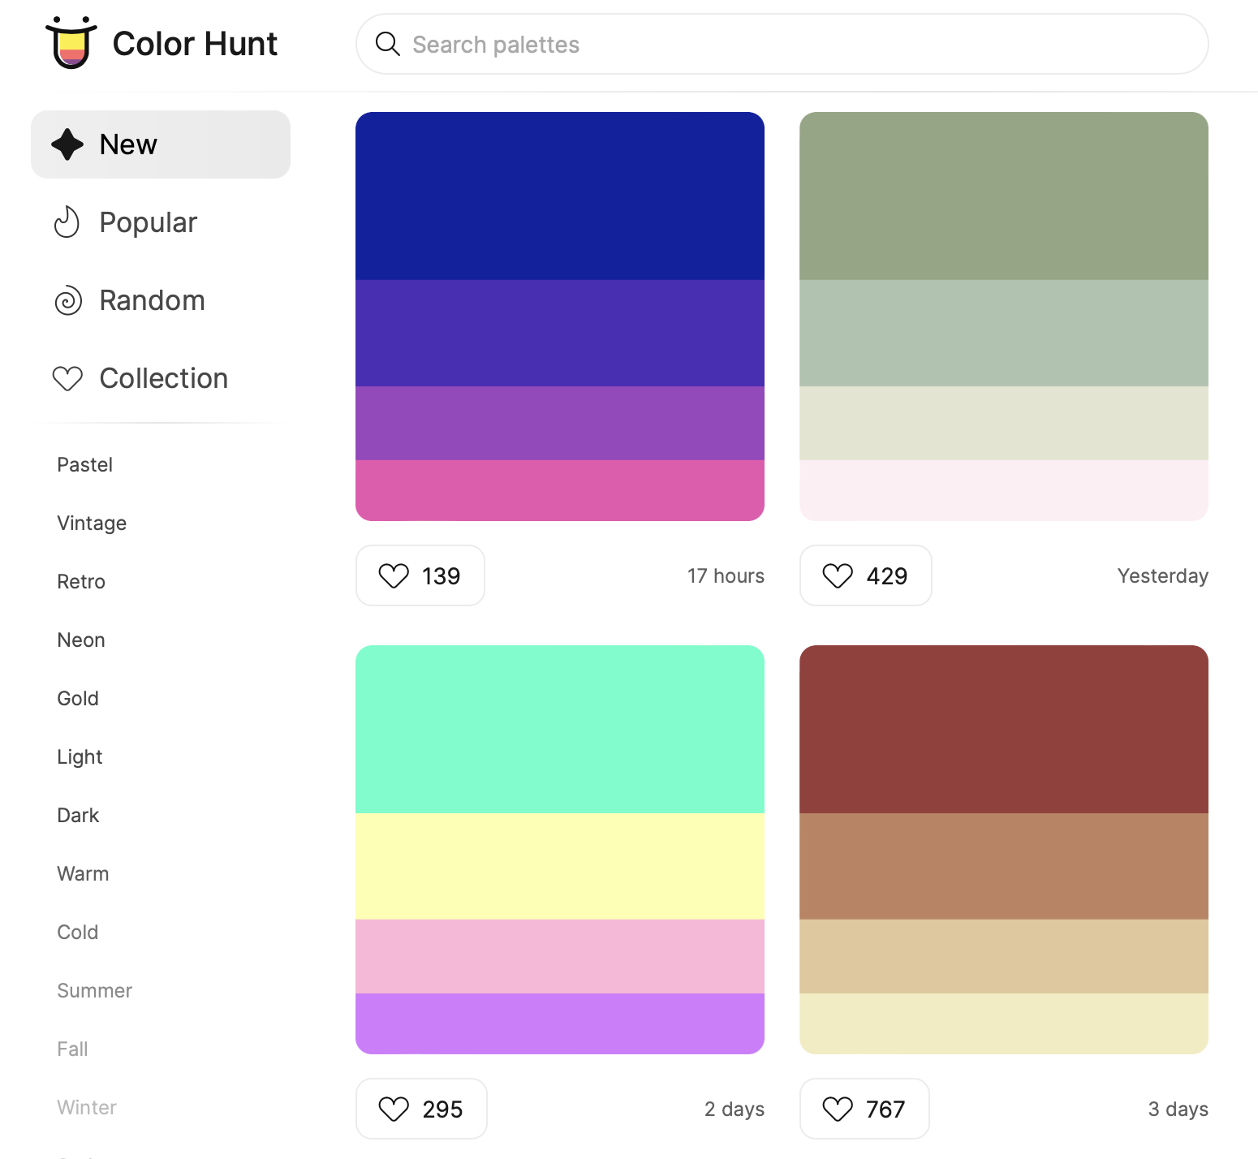
Color Hunt
Color Hunt: open collection of color palettes
In a palette: shades for background and contrasting shades for foreground

Slide 5
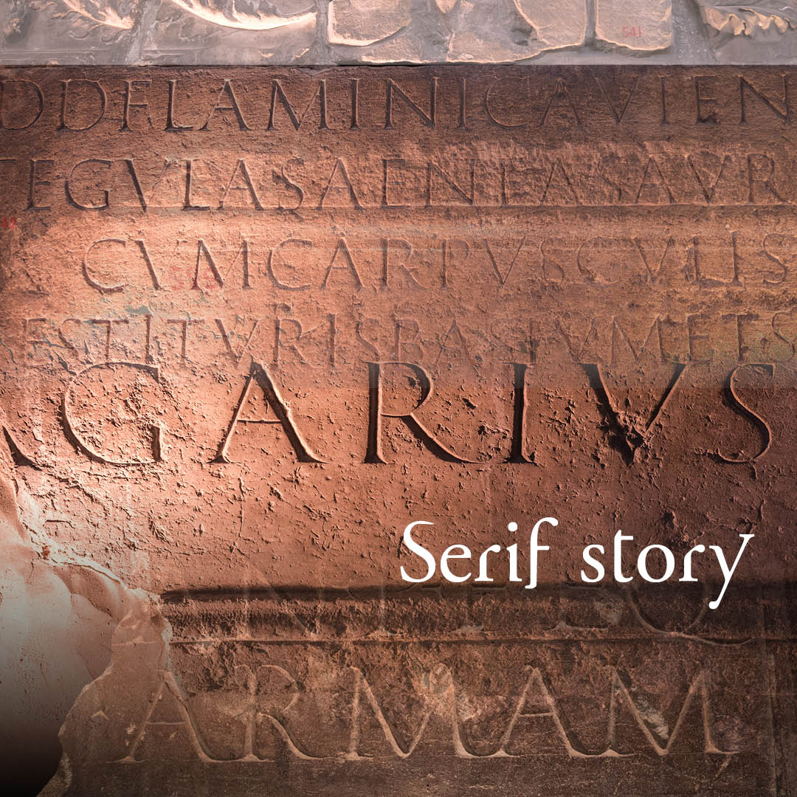

Fonts
Difficult to curve out in stone 90º edges
Sans Serif

Slide 6
Serif Font Families
Old Style
Transitional
Modern
Slab-Serif
American Typewriter
Garamond
Times New Roman
Didot
Hole
Hole
Hole
Hole

Slide 7
Sans Serif Font Families
Grotesque
Neo-Grotesque
Humanist
Geometric
News Gothic
Helvetica
Gill Sans
Futura
Hole
Hole
Hole
Hole

Slide 8
Font Families and Readability
Sans Serif Type Font – Grotesque – News Gothic: 0O
Compare
Sans Serif Type Font – Humanist - Gill Sans: 0O
In Human-Machine Interaction, these styles make the difference between life and death

Slide 9


Using Fonts in your App
Contrast Serif-ness
Serif in Header
Sans Serif in Body
Sans Serif in Header
Serif in Body
Match Mood
My dear love
MY DEAR LOVE

Slide 10
Specify an App in Six Steps

Slide 11
Textual Description
Step 1
In simple words, what your app will do
and why there is need for it
“There is nothing that cannot be fixed with words” - Cicero

Slide 12
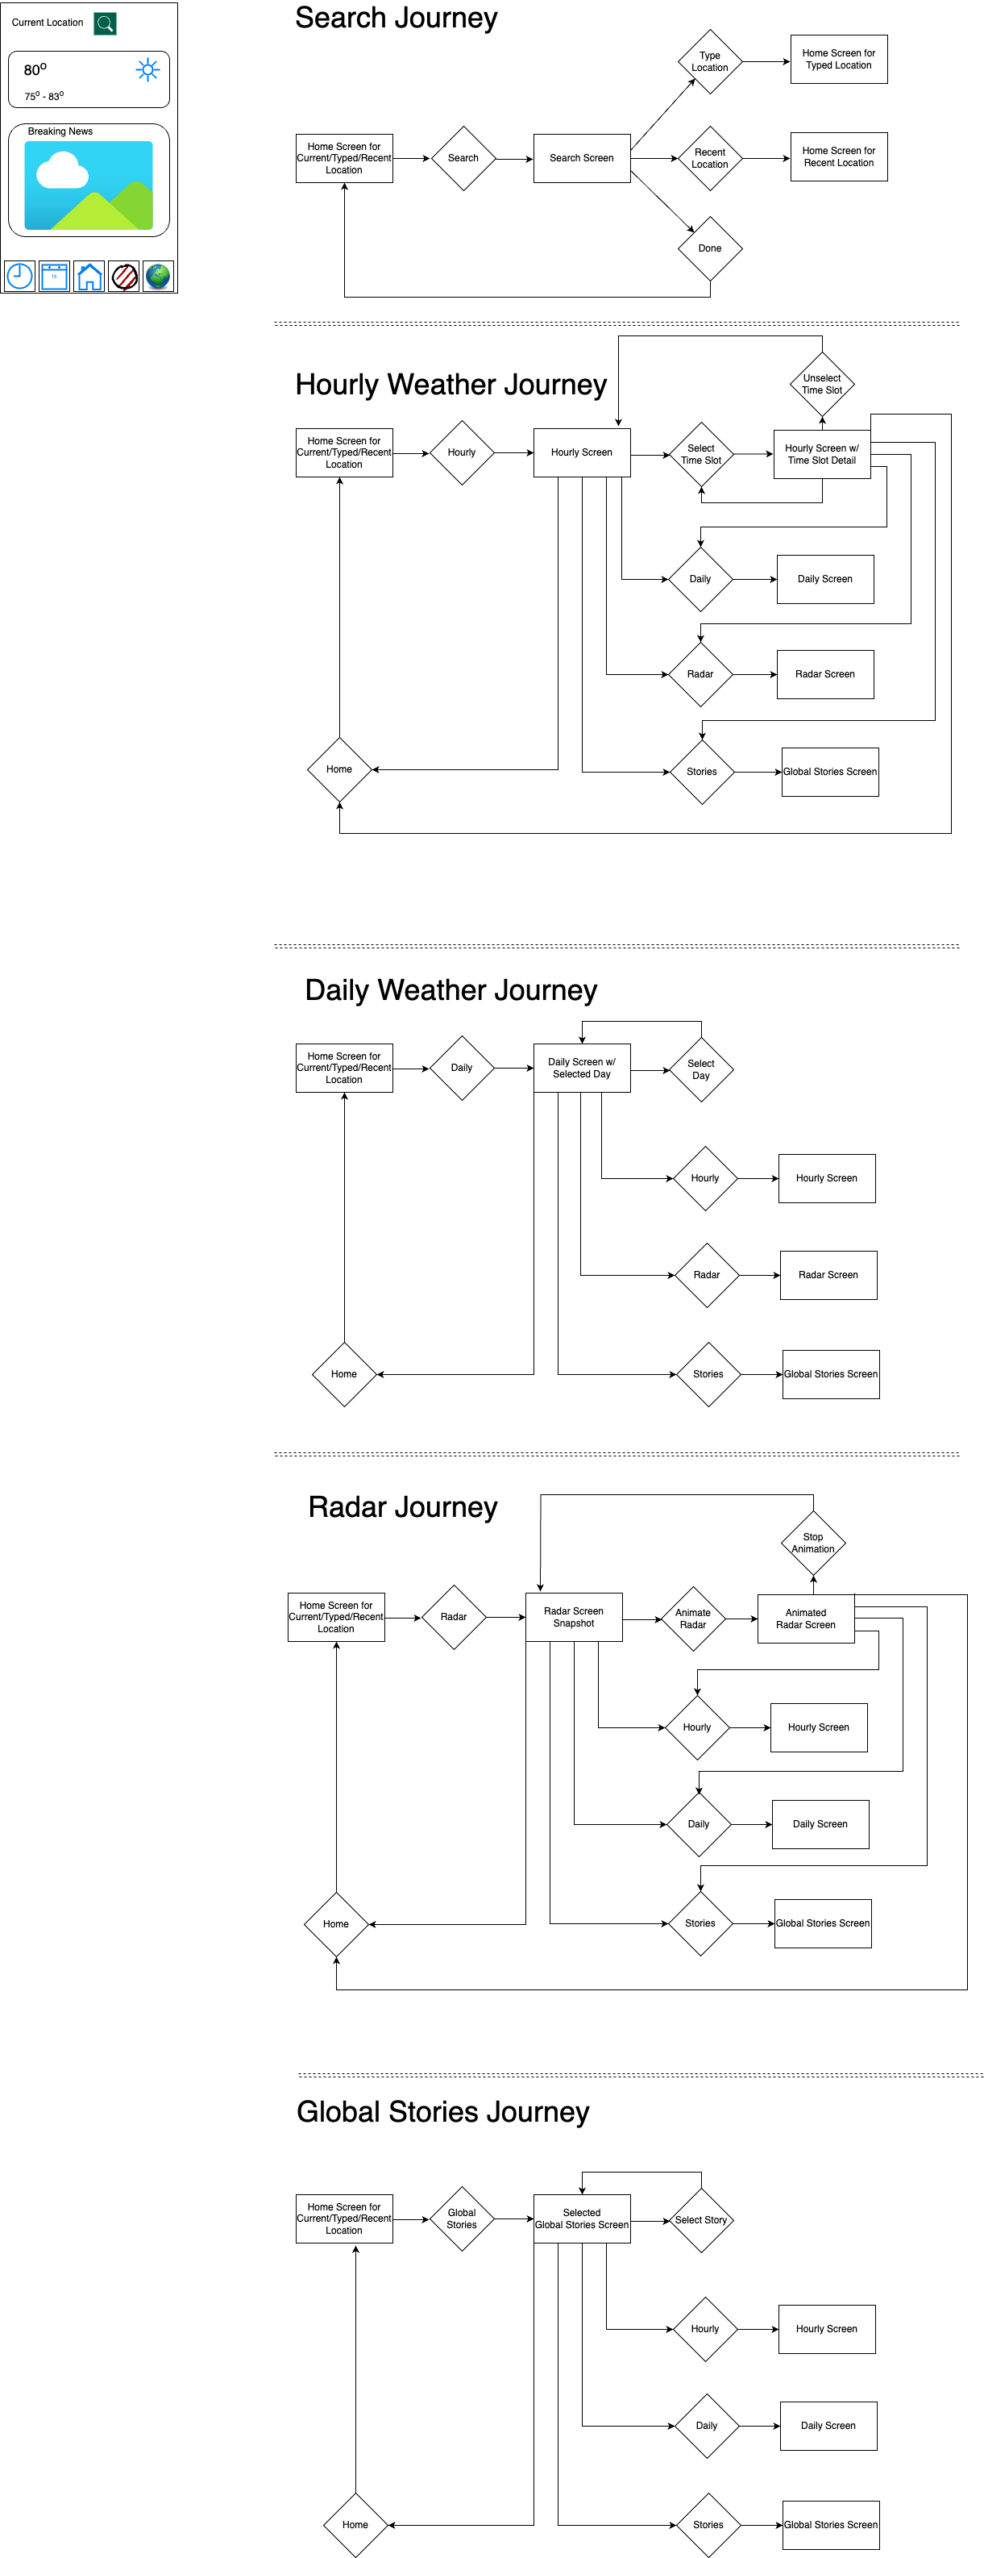
User Flow
Step 2
Use draw.io
To manage complexity, opt for user journeys
e.g., in a bank app, show a user journey for a deposit and another one for withdrawal

Slide 13
User Flow to Wireframes
Step 3
User Flow
Wireframe
An outline of how your app will look like
You can use Figma to create wireframes

Slide 14
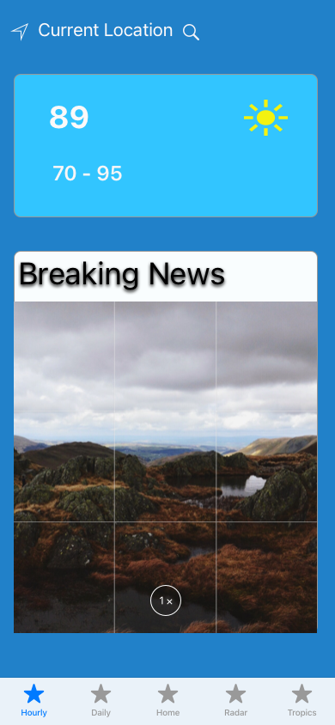
Wireframes to Mockups
Step 4
Wireframe
Mockup
Use Figma to add `flesh’ to your wireframes and turn them into mockups

Slide 15
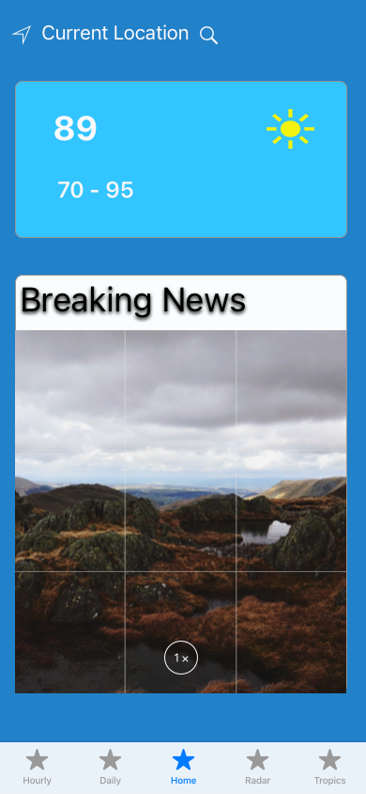
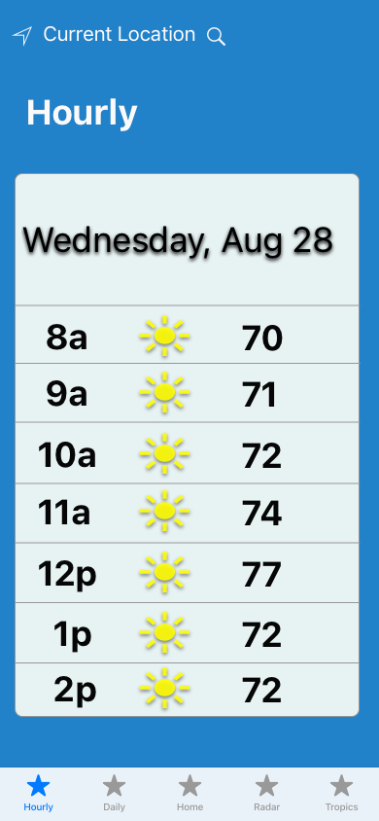
Mockups to Prototypes
Step 5
Prototypes = Animated Mockups
Use Figma to animate mockups

Slide 16
Design Patterns
Step 6
Time to think of software …
Use the appropriate design pattern to plan your code

